Slide 1
Computer Architecture: Layers of Programs
Dr. Colin O’Flynn

Slide 2
e.g., A Computer Program
#include <stdio.h>
int main(void) {
printf(“Hello World\n”);
return 0;
}

Slide 3
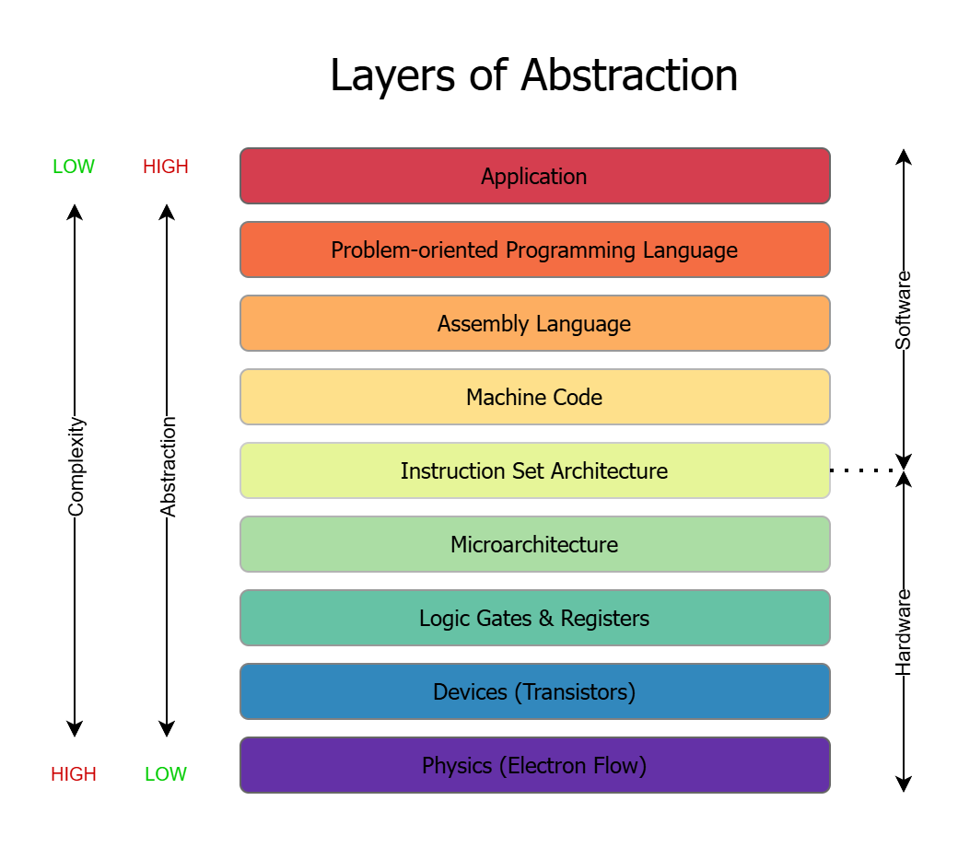

Slide 4
Considerations Between Layers
Each layer makes assumptions in both directions.
Failing to understand these assumptions & limitations causes:
Bugs
Security flaws
Poor performance (or at least not maximum possible performance)
Code that doesn’t even work

Slide 5
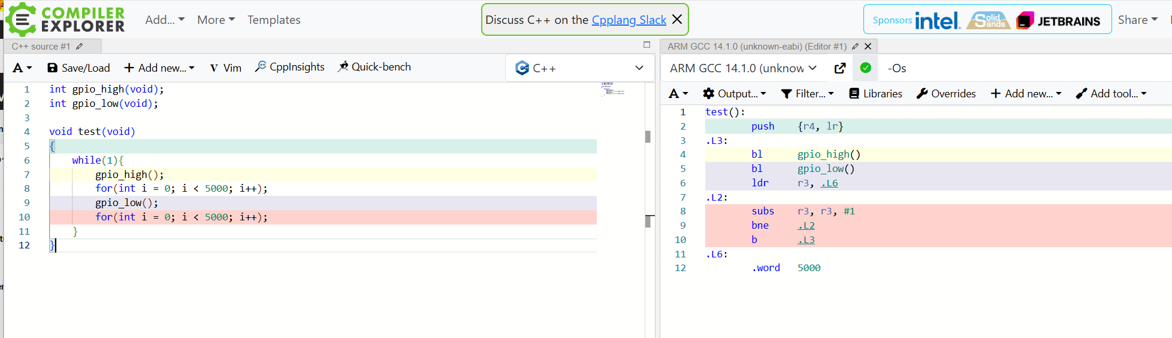
SIDEBAR: “Compiler Explorer” (Godbolt.org)

Slide 6
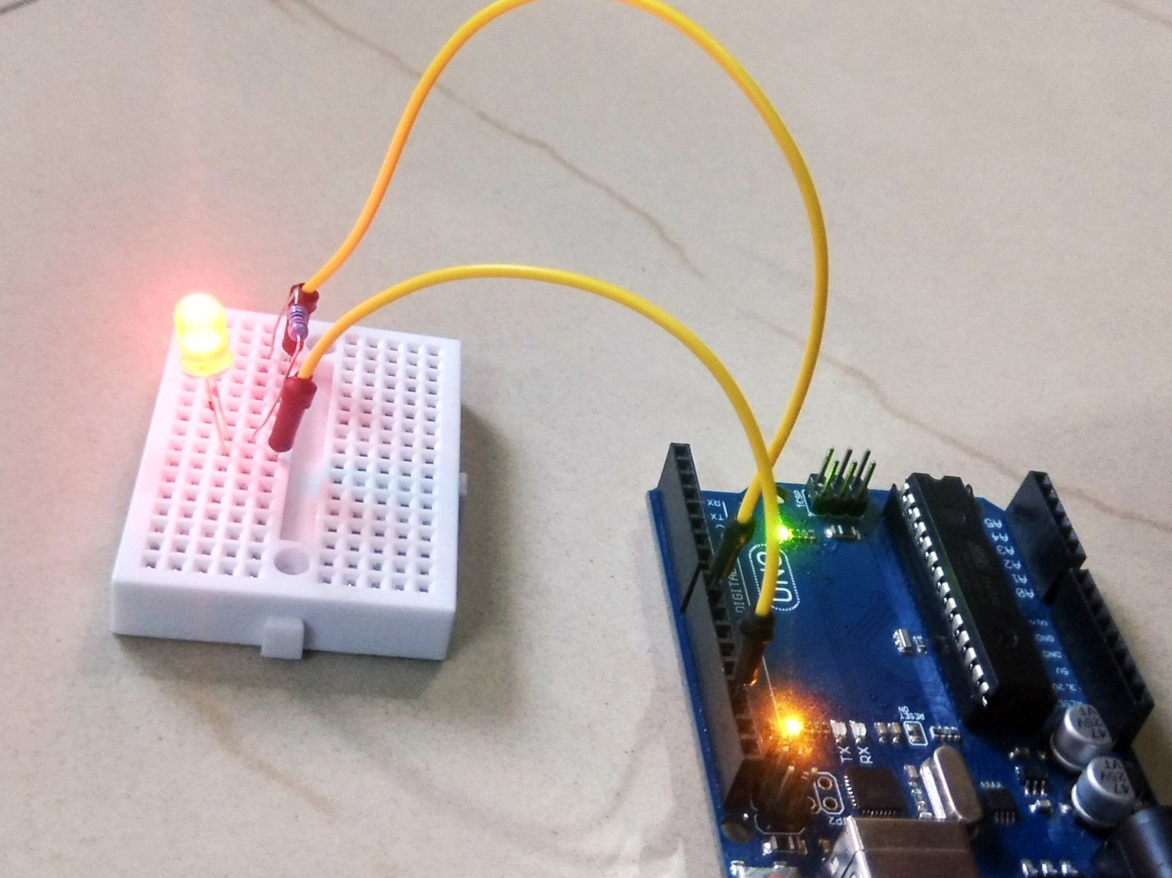
Example #1 : Blinking an LED (Application)

Slide 7
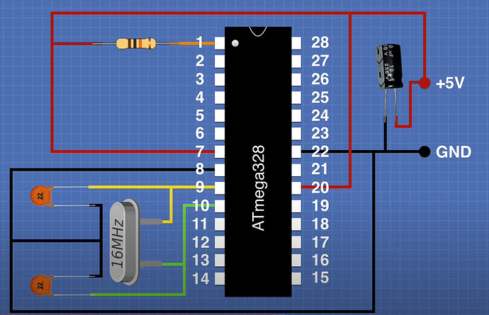
Example #1: Blinking an LED (High Level Code)
int gpio_high(void);
int gpio_low(void);
void test(void)
{
while(1){
gpio_high();
_delay_ms(500);
gpio_low();
_delay_ms(500);
}
}

Slide 8
Example #1: Delays in C on a Microcontroller
int gpio_high(void);
int gpio_low(void);
void test(void)
{
while(1){
gpio_high();
for(int i = 0; i < 5000; i++);
gpio_low();
for(int i = 0; i < 5000; i++);
}
}

Slide 9
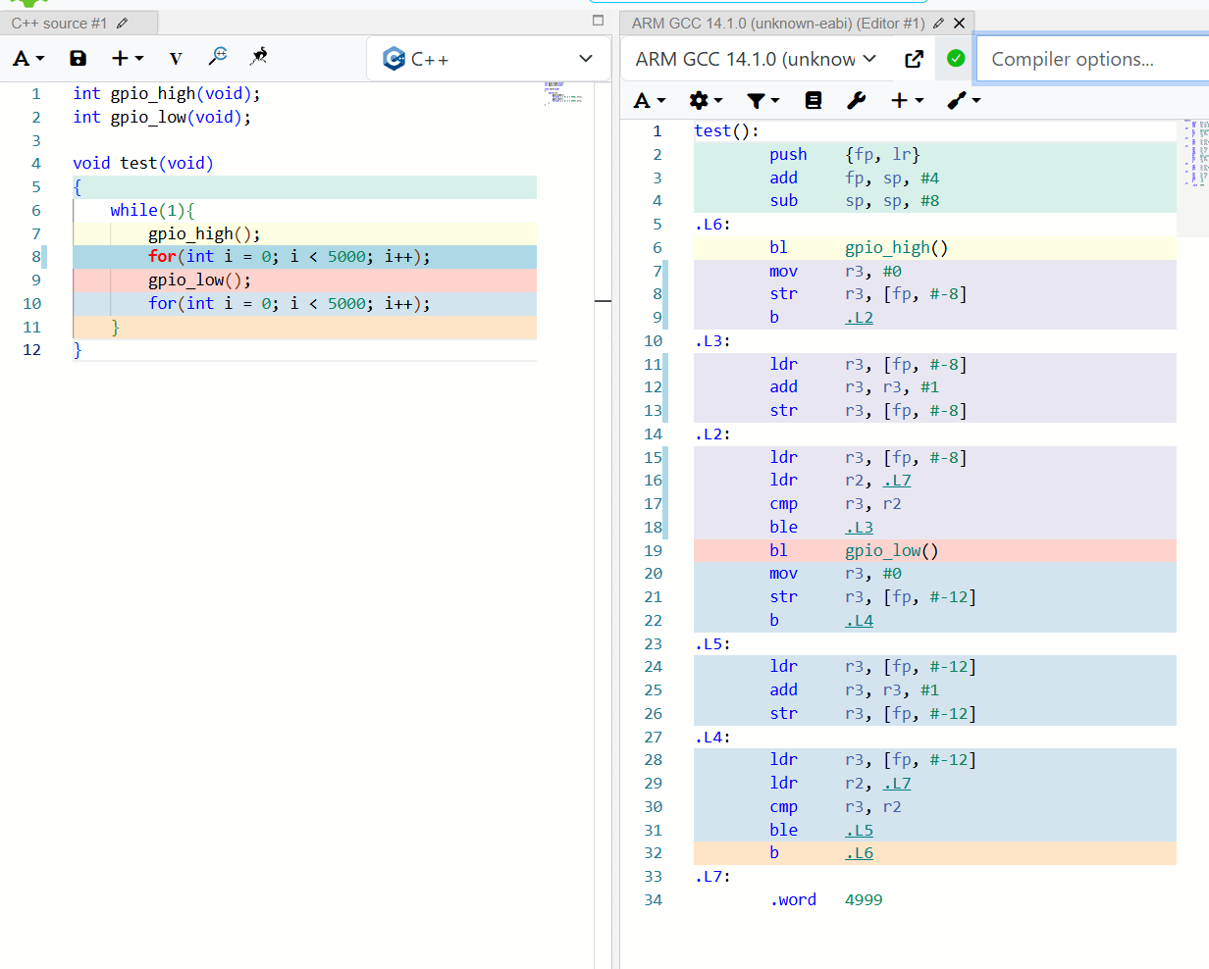
(Backup Slides – Skipped if Live Works)

Slide 10
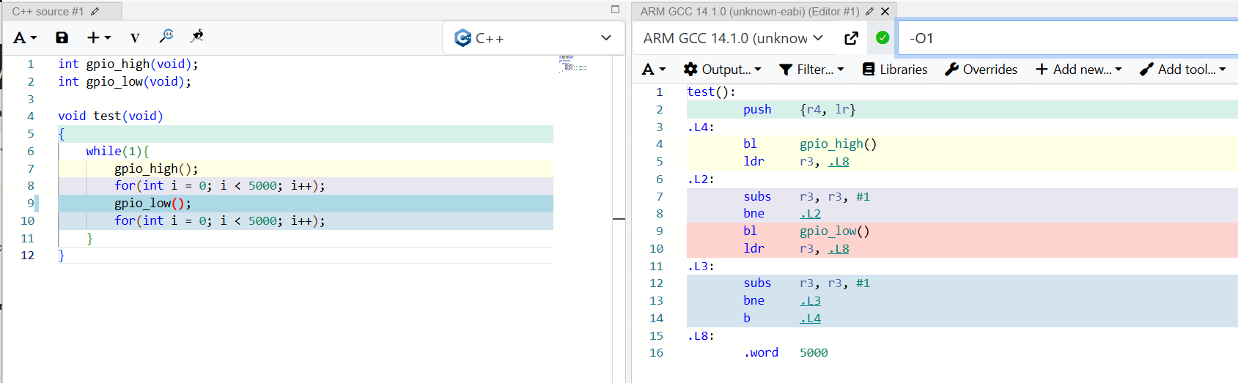
(Backup Slides – Skipped if Live Works)
… that is a little easier to understand!

Slide 11
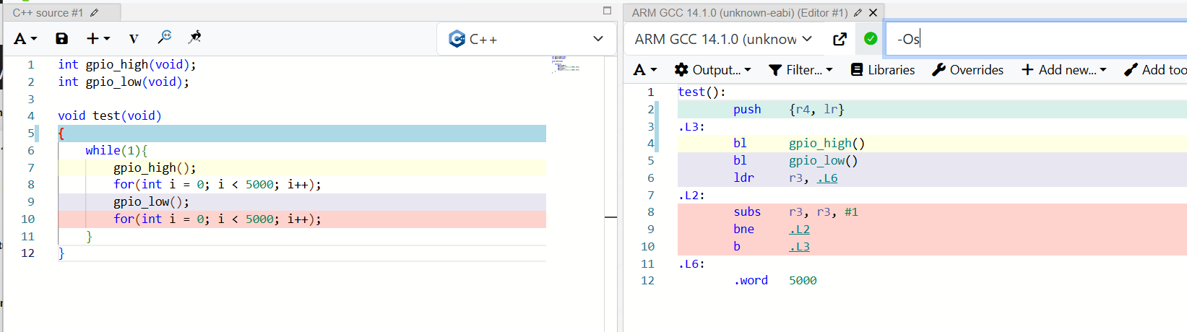
(Backup Slides – Skipped if Live Works)
... What happened to line 8 on the left !?

Slide 12
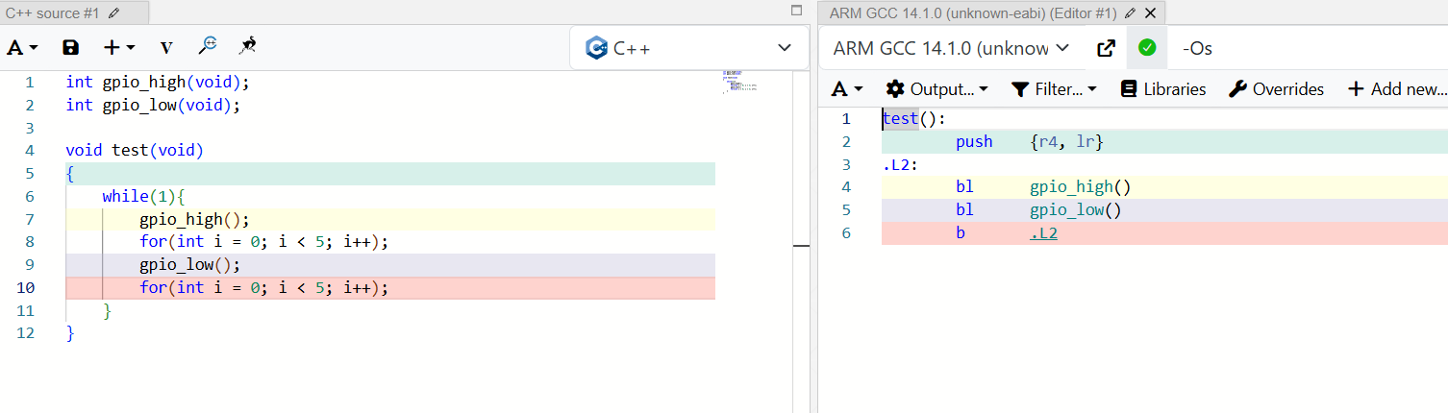
(Backup Slides – Skipped if Live Works)
…Where did the delays go at all?

Slide 13
(Backup Slides – Skipped if Live Works)
…Where did the delays go at all?

Slide 14
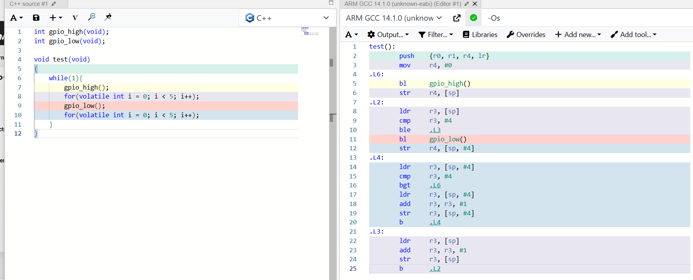
(Backup Slides – Skipped if Live Works)
This tells the compiler not to touch my variable.

Slide 15
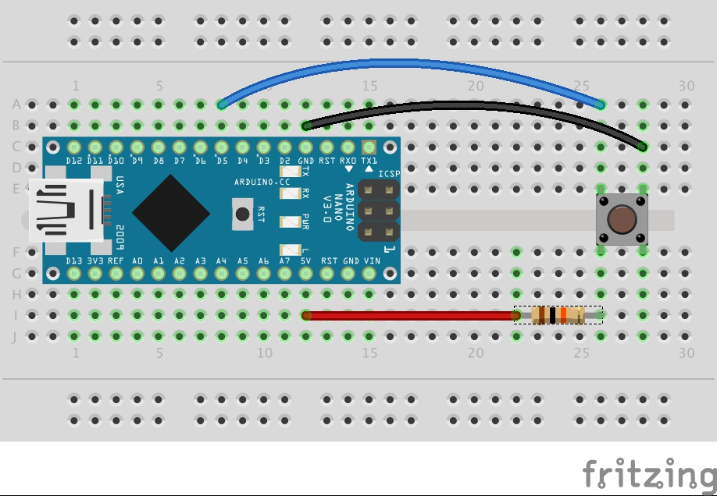
Example #2: Wait for Button Press
int button_status;
void wait_for_button_press(void)
{
button_status = 0;
while(button_status == 0){
;
}
}
void ISR_PinInterrupt(void)
{
button_status = 1;
}

Slide 16
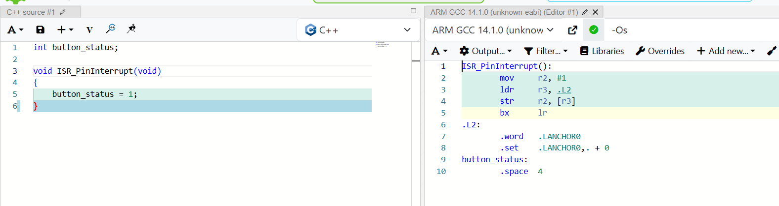
Example #2: Global Variable Setting

Slide 17
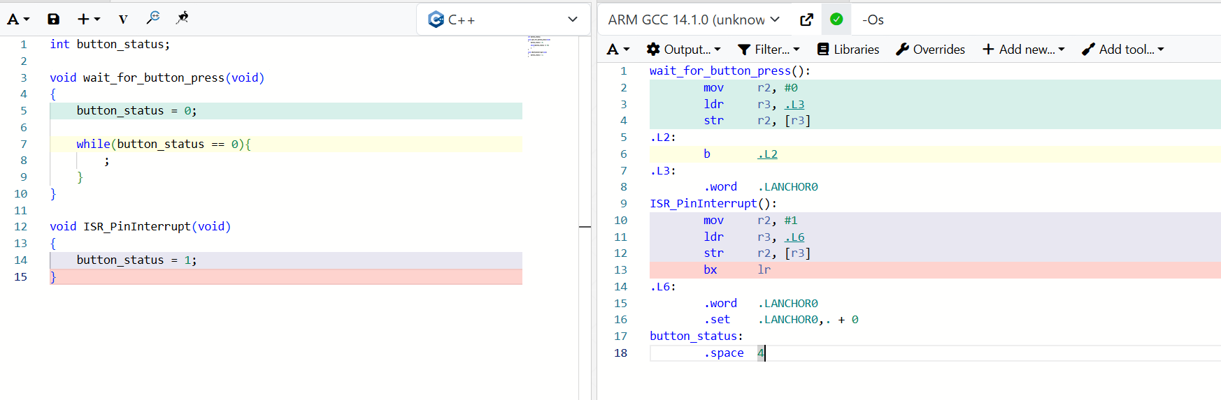
Example #2: Global Variable Setting
Line 6 on the right is an infinite loop!
b .L2 means “Branch to Label .L2”

Slide 18
What was I demonstrating?
The compiler took the High Level Language and made assumptions.
The engineer using the High Level Language didn’t understand what the compiler is going to do.

Slide 19
Application
This is your design intent. This is the most important step in your design.
We won’t cover this in this course – but this follows from many of your design courses.
Define the problem, constraints, etc.

Slide 20
High Level Language
This is what most people think of as “programming”
This can be subdivided further – but consider it could mean:
“Bare Metal” C code
An RTOS or framework (like FreeRTOS or Arduino)
Languages like Python or Java which may be interpreted or compiled

Slide 21
High Level Language
Most Important Embedded Languages (this is purely my opinion)
C: Most common in small embedded systems but used all over.
C++: Common in larger systems, especially Linux based applications.
Java: Now mostly used for Android development. Many embedded systems run Android however.
Rust: A newer memory-safe language, designed to be usable in place of C. Especially popular among Google as developed there (but used extensively outside as well)

Slide 22
High Level Language
This is the last level at which the code is “machine independent”.

Slide 23
Intermediate Representation
Compilers have another step that is hidden from us – a language the compiler uses internally for optimizations.
We’ll look at this in more detail in the next lecture.

Slide 24
Assembly Language
Assembly Language is not machine code.
Assembly Language is human readable code – remember it is further modified by the Assembler.
Assembly language is specific to processors. For example, you may see any of the following:
Atmel AVR
Arm
RISC-V
x86
8051 (old but still in wide use)
MIPS
PowerPC
Z80 (very uncommon now)

Slide 25
Assembly Example:
int check_variable_add(int a, int b){
int c;
if (a == 2){
c = a + b;
} else {
c = a - b;
}
return c;
}
(NOTE: Following slides have static versions – use Godbolt.org and change compiler to see it live)

Slide 26
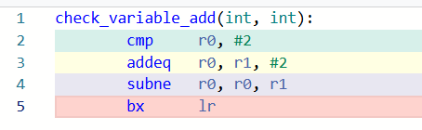
ARM

Slide 27
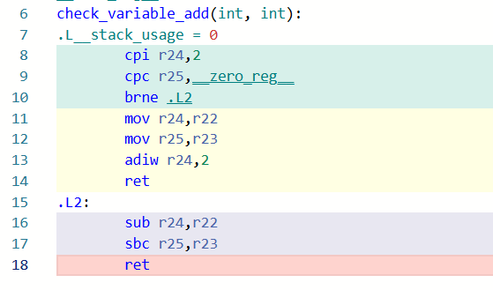
AVR

Slide 28
(Another example of Design Intent vs. Compiler)
My choice of “int” has a specific meaning in C. This forces a longer assembly implementation than if I used an 8-bit “char”.

Slide 29
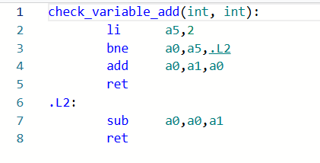
RISC-V

Slide 30
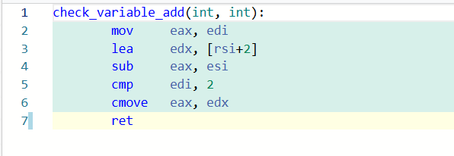
x86

Slide 31
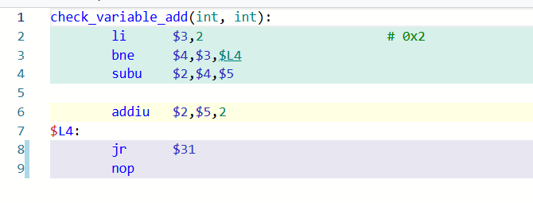
MIPS

Slide 32
MIPS
MIPS has more fundamentally “out of order” execution. This instruction is always executed.

Slide 33
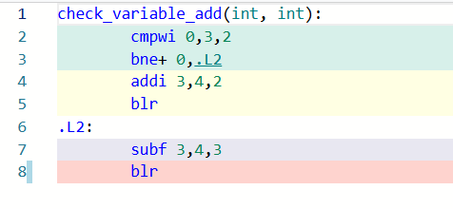
PowerPC

Slide 34
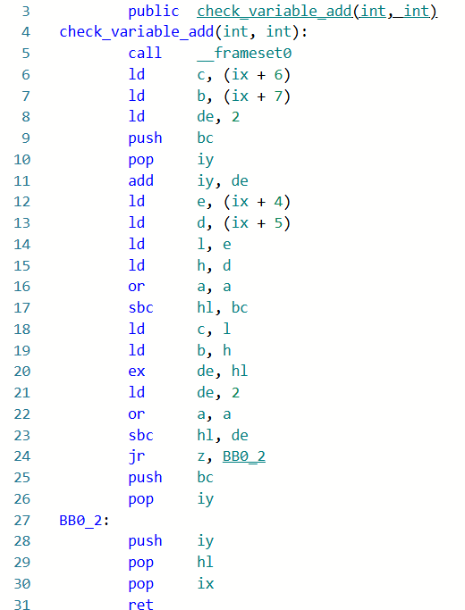
z80

Slide 35
Machine Code
What the machine sees.
This is the 1’s and 0’s encoded on “something”.
The machine code normally has some relation to how the code is being interpreted or used.
The machine may still make assumptions about things and does not blindly execute.

Slide 36
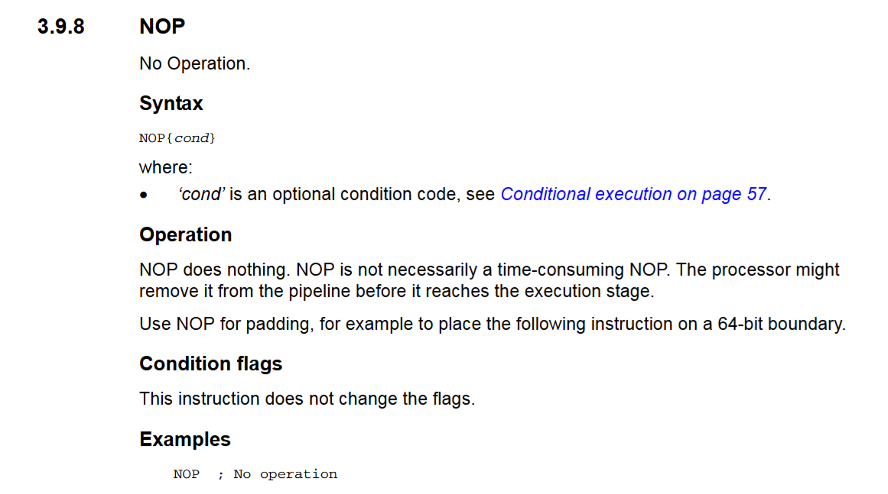
e.g., “No Operation” (NOP)

Slide 37
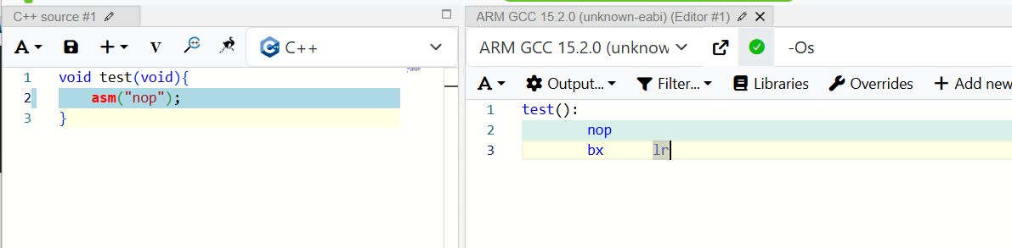
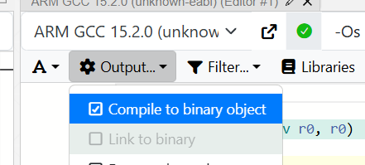
More Assumptions Compiler/Assembler

Slide 38
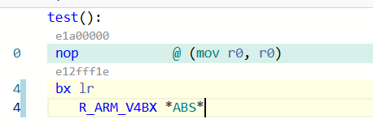
NOP isn’t even used!!!
This does nothing as well (but isn’t the “nop” instruction)

Slide 39
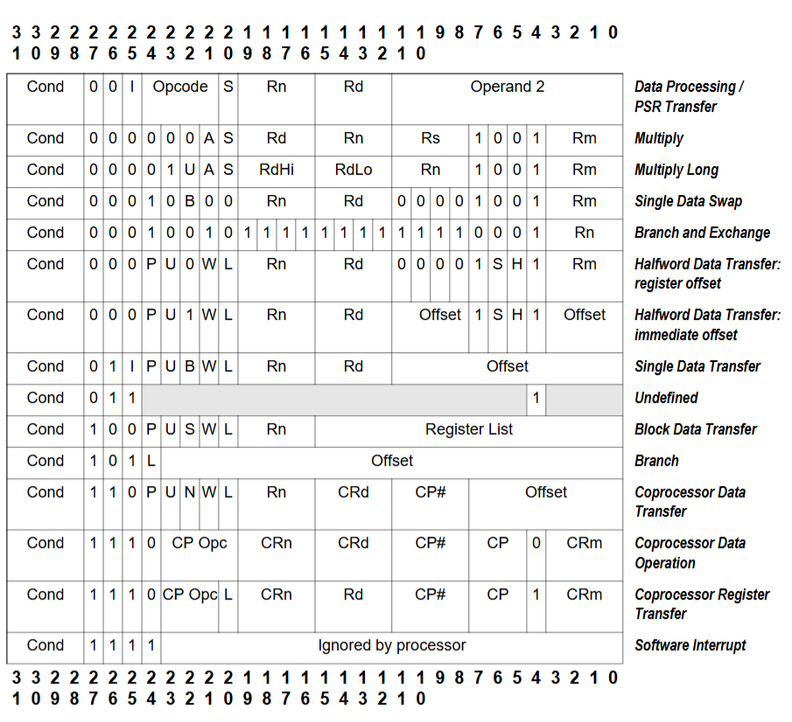
Arm Machine Code Example
https://vision.gel.ulaval.ca/~jflalonde/cours/1001/h17/docs/arm-instructionset.pdf

Slide 40
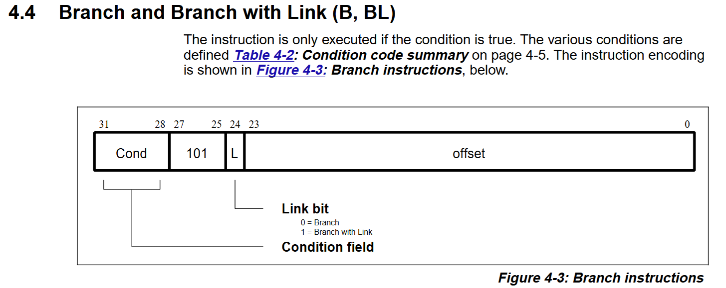
Arm Machine Code Example
https://vision.gel.ulaval.ca/~jflalonde/cours/1001/h17/docs/arm-instructionset.pdf

Slide 41
Instruction Set Architecture (ISA)
ISA is actually the specification or design document about how the processor works (the diagram at left could combine machine code & ISA).
ISA defines:
Opcodes
Registers
Memory models
Instruction Encoding
…etc

Slide 42
Instruction Set Architecture (ISA)
The ISA is a core part of this course, we’ll be talking about those aspects in great details.
Some ISA specifications are open-source (RISC-V). This does not mean every implementation of them is Open.
Non Open-Source mean you cannot even implement it without some license agreement ($$$).

Slide 43
Microarchitecture
This defines how the implementation of the ISA is done.
The same ISA may have different implementations (microarchitectures).
Example – your implementation may choose to optimize:
Low-power (best battery life).
Lowest cost.
Highest performance (best speed).

Slide 44
Example of Trade-Offs
Low-power & low-cost may have similar goals: minimal area (gates).
Re-use logic as much as possible. Serial calculations that may need to wait for resources to be free.
High-performance
Task-specific logic, duplicated logic. Use parallel calculations where possible.

Slide 45
Microcode vs. Hardwired

Slide 46
Advantages / Disadvantages
Hardwired | Microcode
Implemented with fixed logic – cannot be modified or extended. | Implemented with a microprogram – possible to update this to change/add instructions, sometimes even possible "in the field".
Normally faster due to direct hardware usage. | Normally slower do to microinstruction execution.
Complexity/size can increase substantially as more functions needed. | Complexity/size mostly in software – scales well with large changes or for new functions.

Slide 47
Logic Gates & Registers
This will be the hardware design itself using gates/flip-flop. Normally defined at the state of "RTL" (Register-Transfer Level).
Examples of RTL are Verilog and VHDL.
Many blocks are still abstractions at this layer – for example memory (SRAM/FLASH) are defined by the foundry.

Slide 48
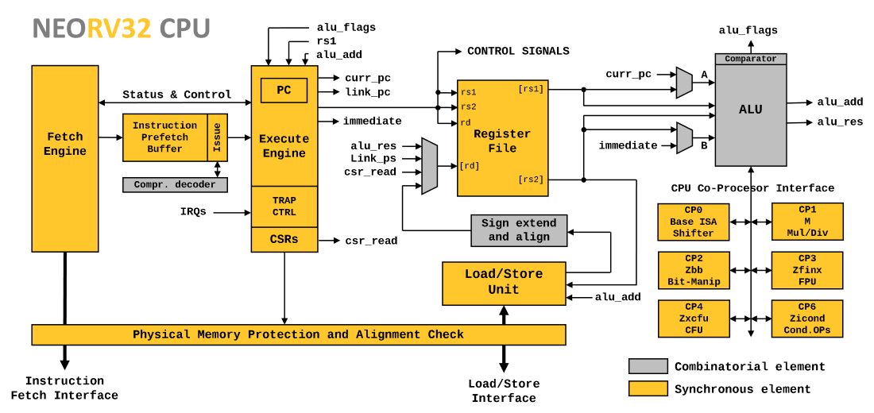
RTL Example from neorv32
Open-source RISC-V Processor, see https://github.com/stnolting/neorv32

Slide 49
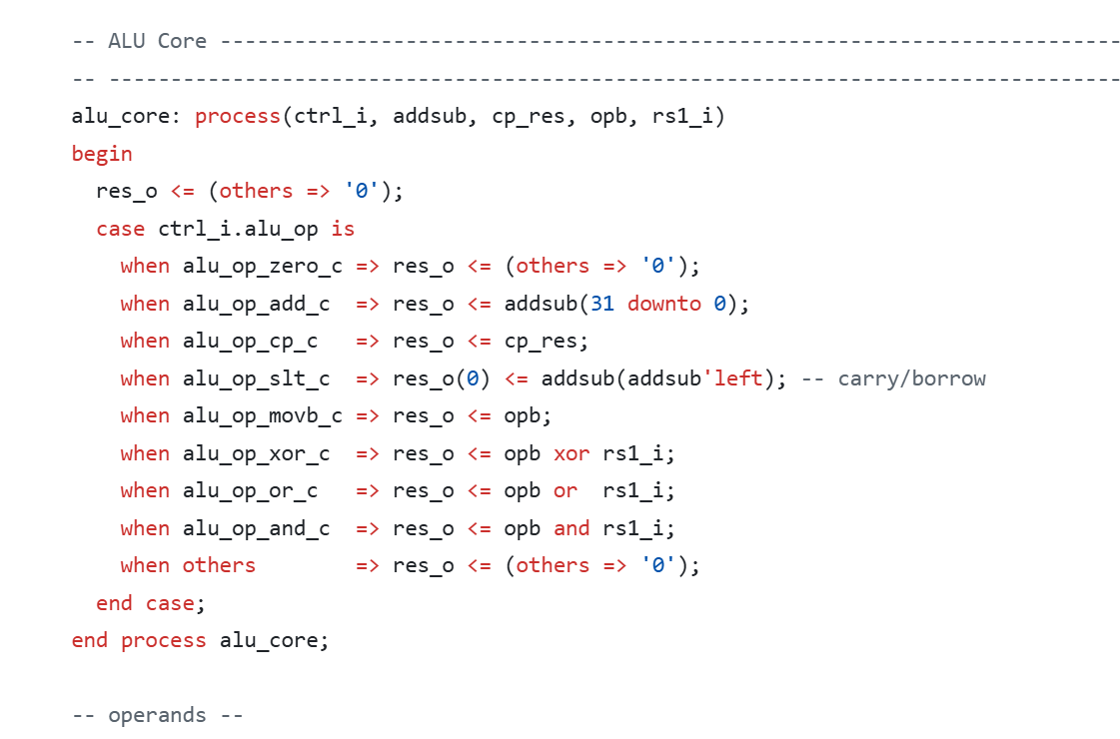
e.g., ALU Core
https://github.com/stnolting/neorv32/blob/main/rtl/core/neorv32_cpu_alu.vhd
https://github.com/stnolting/neorv32/tree/main/rtl/core

Slide 50
RTL Warning / Note
RTL describes hardware – it looks like software but is not. Everything happens concurrently unless otherwise described elsewhere.
I don't plan on diving into RTL in this course unless there is a strong interest in it (Digital Circuits should have introduced it & you'll get more in IC Design if you choose)

Slide 51
Transistor Level
The output of the RTL tools goes here – if targeting a FPGA will be based on the gate array. If targeting an ASIC requires additional synthesis steps.

Slide 52
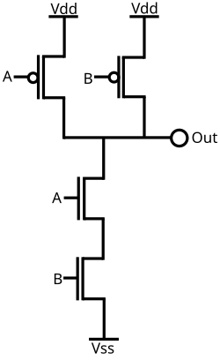
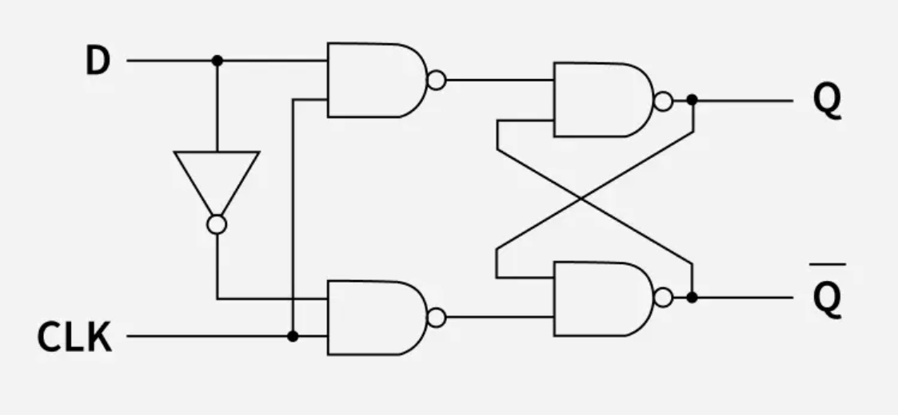
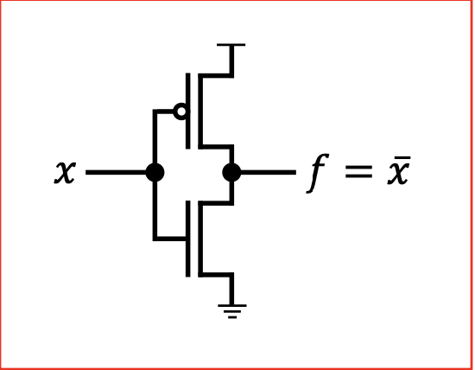
Synthesis Example – 1 bit D Flip-Flop
= 18 transistors total!

Slide 53
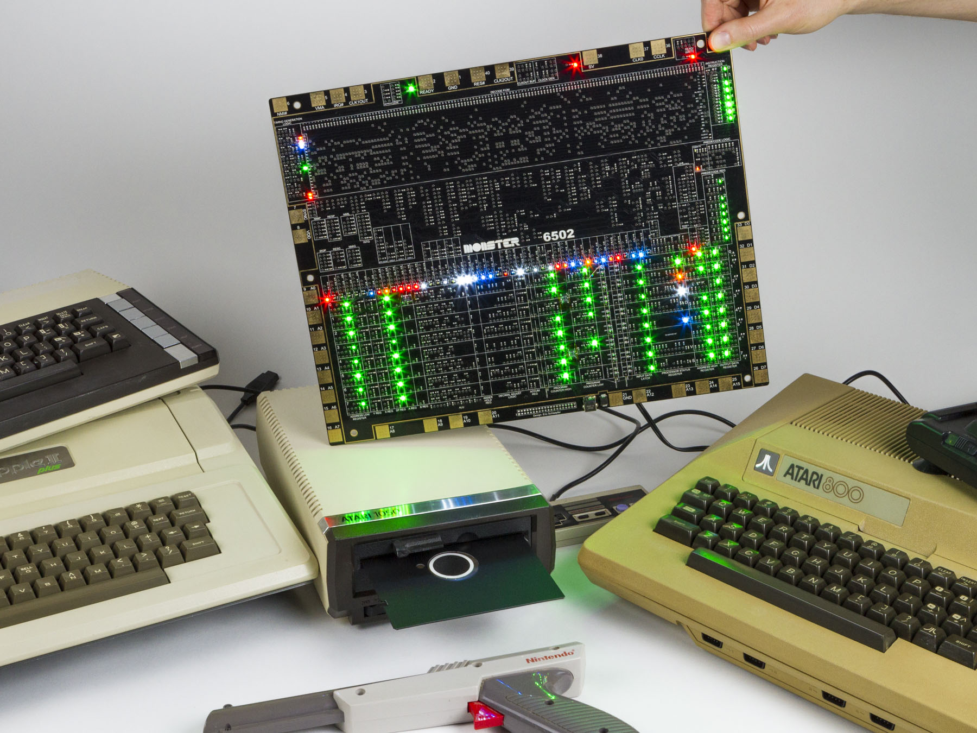
e.g., Discrete Transistor Level
https://monster6502.com/

Slide 54
Implementation Level
The output of the RTL tools goes here – if targeting a FPGA will be based on the gate array. If targeting an ASIC requires additional synthesis steps.

Slide 55
Standard Cell Designs
Most foundries provide standard cells – you don't actually synthesize everything to transistor level yourself.
Allows foundry to optimize for specific process.
Blocks could include gates, flip-flops, SRAM, etc. Normally also includes simulation data required to validate your design.

Slide 56
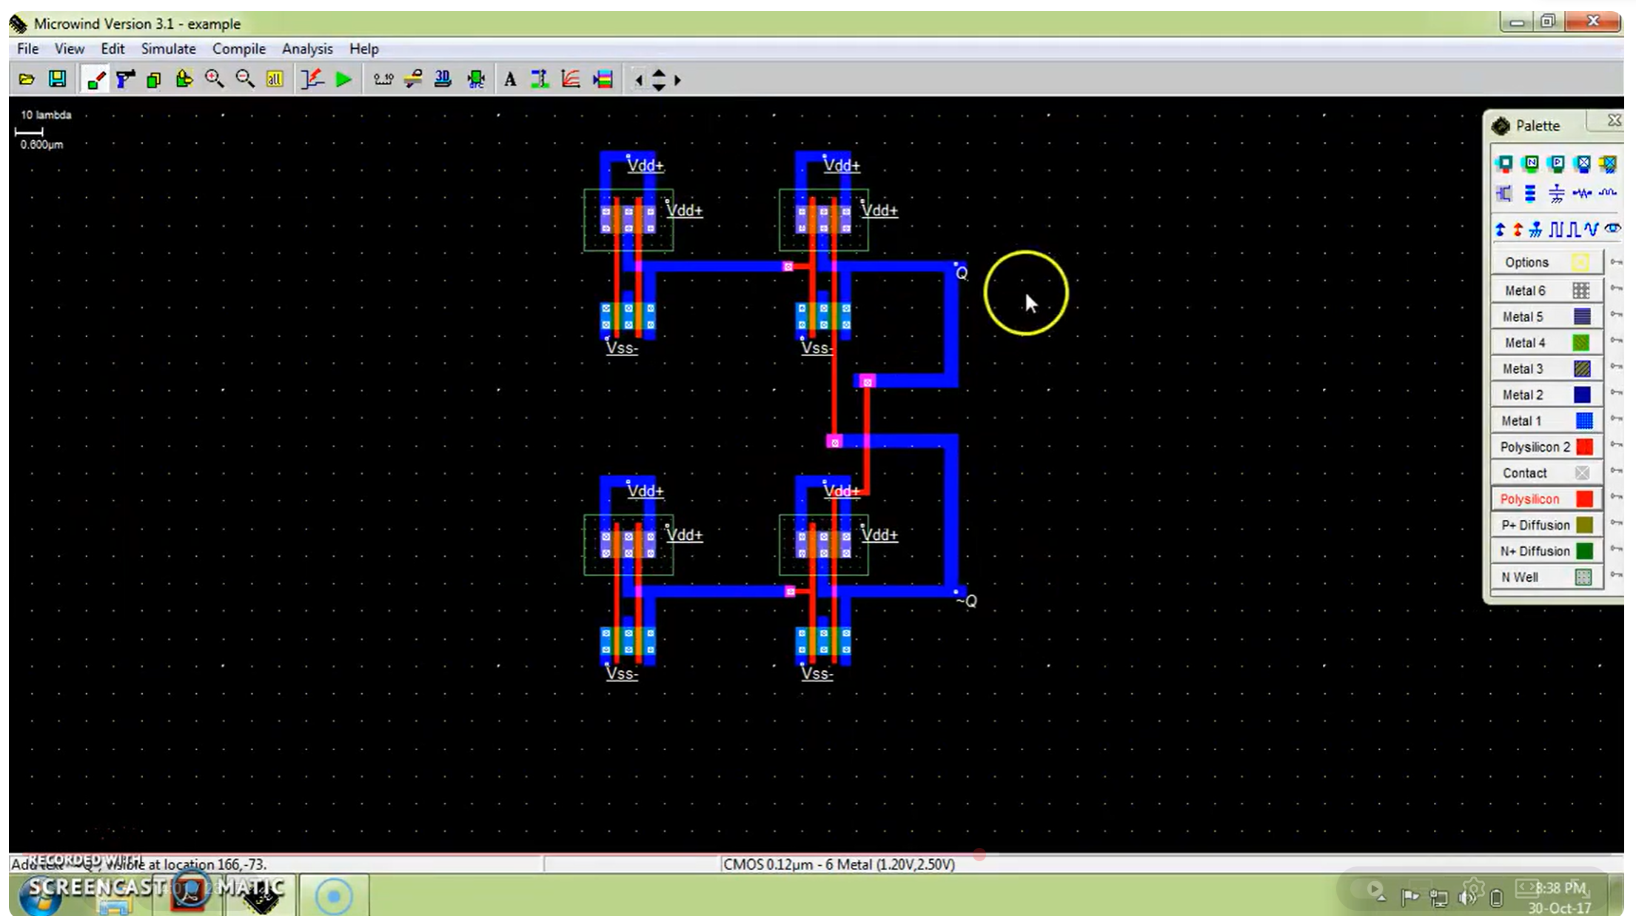
e.g., D FF Layout
https://www.youtube.com/watch?v=x8lkfS7IFIw

Slide 57
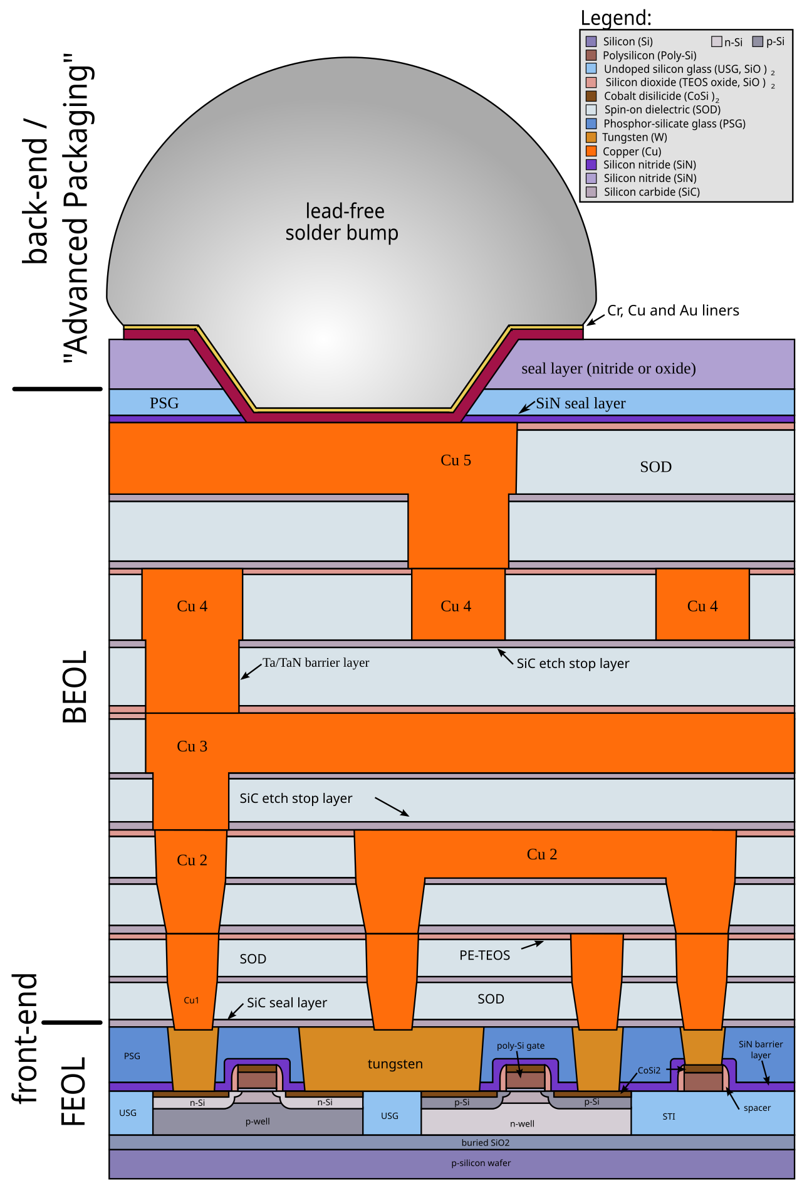
Implementation Level
Specifics of voltage & process are needed at this stage.
Will define the maximum frequency the device can operate at.

Slide 58
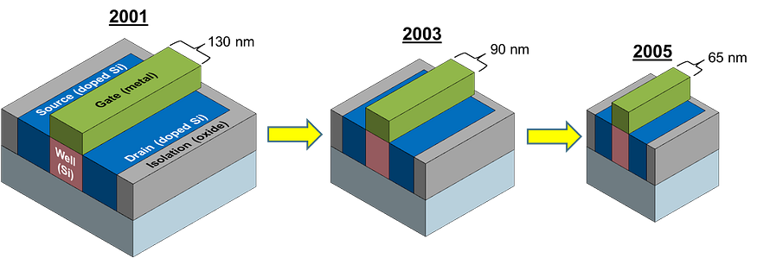
Gate Width?
https://medium.com/predict/a-node-by-any-other-name-transistor-size-moores-law-b770a16242e5

Slide 59
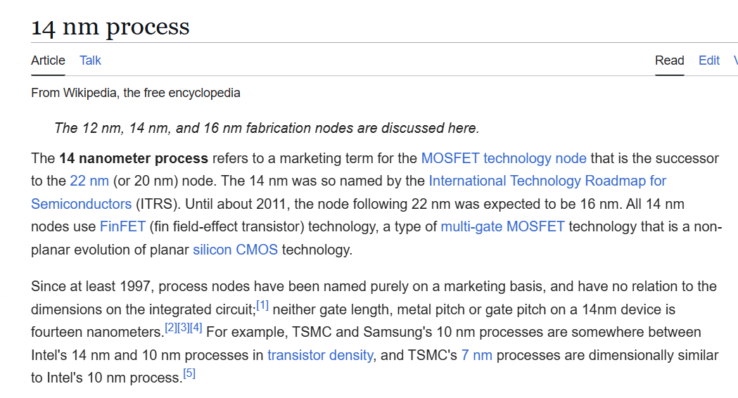
Gate Width?
No longer true – note that latest node names are purely marketing.

Slide 60
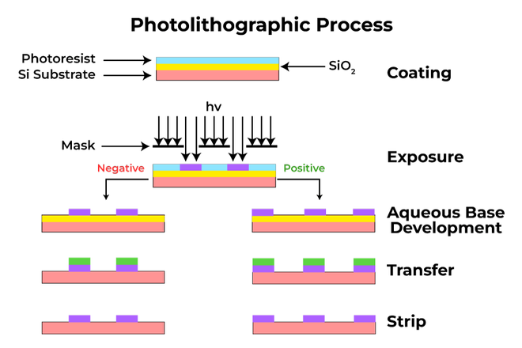
Making the Chips

Slide 61
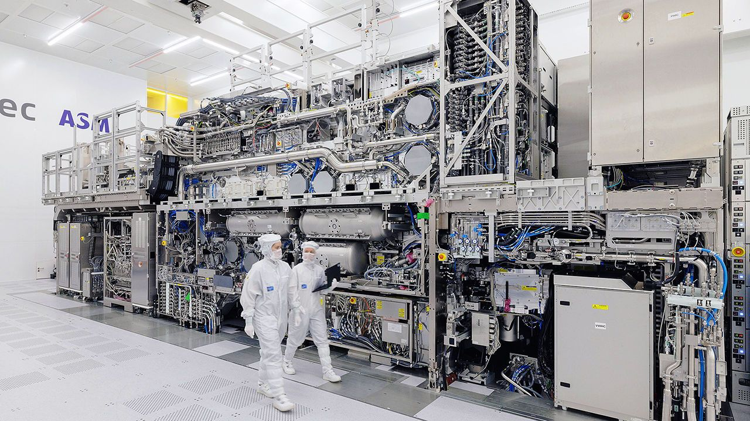

Slide 62
Microprocessors
This course lives here!
Digital Circuits
IC Design Course

